Slide 1
Memory Management

Slide 2
Memory
CPU can only access content from main memory and registers (built into processor)
Data / instruction can not be read from secondary storage by processor . It needs to be moved from secondary storage to main memory.

Slide 3
Memory Management
Three design constraints of memory subsystem
Size
Speed
Cost
Across the spectrum of the technologies following relationship holds
Smaller access time , greater cost per bit
Greater capacity, smaller cost per bit
Greater capacity , greater access time
Memory subsystem requirement
Large capacity, fast access time and low cost

Slide 4
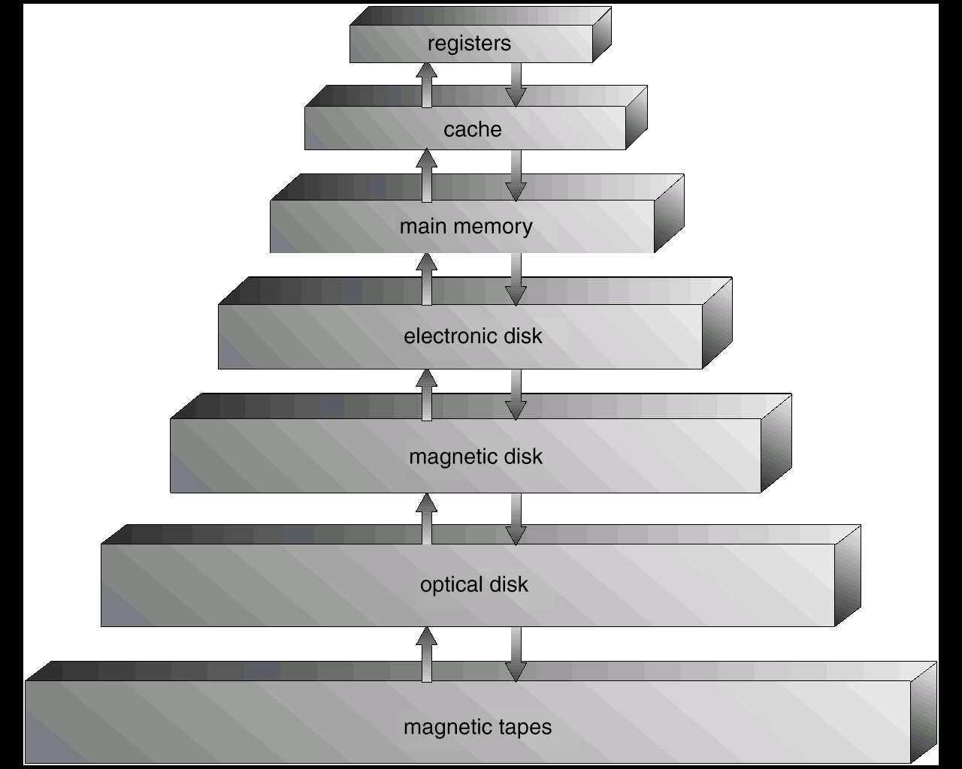
To meet the contradictory design requirement , organize memory in hierarchical manner

Slide 5
As one goes down the Hierarchy , the following conditions occur:
Decreasing cost per bit
Increasing capacity
Increasing access time
Decreasing frequency of access of the memory .

Slide 6
Example (two level memory)
Processor has access to two level of memory
Level 1 contains 1000 words and access time(T1) is 0.1 Micro second
Level 2 contains 100,000 words and access time (T2) is 1 Micro second
If the word is found in level 1
then it is accessed in 0.1 Micro sec
else 1.1 micro sec

Slide 7
T1+T2
T2
T1
Fraction of access involving only level 1
1
0

Slide 8
Observations
We observe that if memory access at level 2 is less frequent then overall access time is close to level 1 access time
The basis for validity of this condition is a principal known as locality of reference
During course of execution of program , memory references for both data and instruction tends to cluster

Slide 9
Memory Management Requirement
Relocation
Protection
Sharing
Logical organization
Physical organization

Slide 10
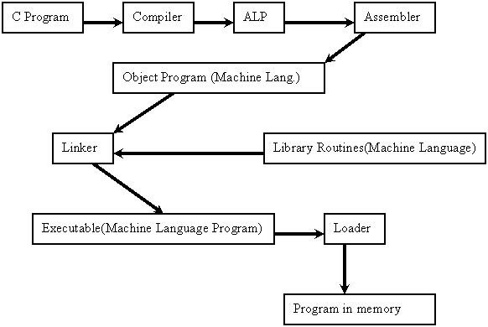

Slide 11
Binding of Instructions and Data to Memory
Address binding of instructions and data to memory addresses can happen at three different stages.
Compile time: If memory location known a priori, (starting location) absolute code can be generated; must recompile code if starting location changes. Example MS DOS .COM format programs.
Load time: Must generate relocatable code if memory location is not known at compile time. Final binding is delayed until load time. If the starting address only changed then we need to reload the user code to incorporate the changed value.
Execution time: Binding delayed until run time if the process can be moved during its execution from one memory segment to another. Need hardware support for address maps (e.g., base and limit registers). Most general purpose operating systems use this method.

Slide 12
Loading Program into main memory
it is assumed that OS occupies some fixed portion of memory and rest is available to user processes.
Based on requirement and functionality different memory management methods are adopted.
Should the process be allocated memory in contiguous manner?
How the User program / data area is managed?
Static/dynamic partitioning
Equal /unequal partition

Slide 13
Fixed Partitioning
Main memory is divided into number of fixed size partition at system generation time.
A processes can be loaded into a partition of equal or greater size

Slide 14
Equal size fixed Partition
Easy to implement
If total user memory space is X and size of partition is Y, ( Y< X) then number of partitions in system will be X / Y. This is the maximum number of processes that can be loaded in the memory at any given time
If program size is much smaller than the size of partition, the remaining space is unutilized
A program may be too big to fit into a partition

Slide 15
Overlays
Needed when process is larger than amount of memory allocated to it.
Keep in memory only those instructions and data that are needed at any given time
Implemented by user, no special support needed from operating system, programming of overlay structure is complex

Slide 16
Assembler example -Overlay cont..
Symbol table (20 K)
Common routine (30 K)
Overlay driver (10 K)
Pass 1 (70 K)
Pass 2 (80 K)

Slide 17
Unequal size partition
We create fixed number of unequal size partition
Program is loaded into best fit partition
processes are assigned in such a way as to minimize wasted memory within a partition
queue for each partition

Slide 18
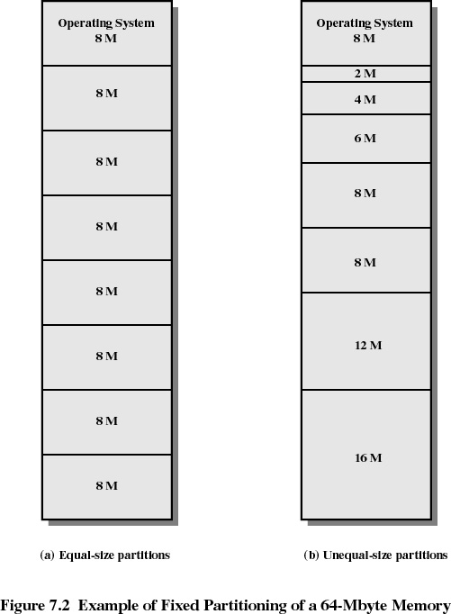

Slide 19
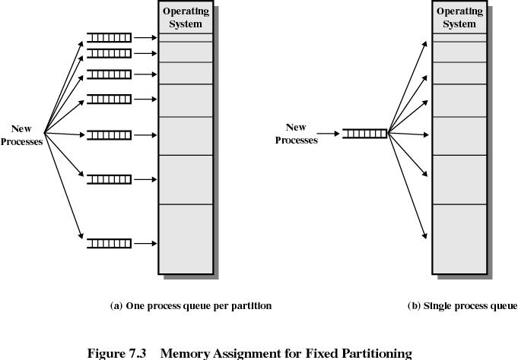

Slide 20
Dynamic Partitioning
Partitions are of variable length and number
Process is allocated exactly as much memory as required
Eventually we get holes in the memory. This is called external fragmentation
Must use compaction to shift processes so they are contiguous and all free memory is in one block

Slide 21
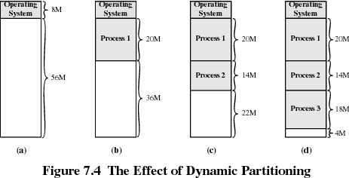

Slide 22
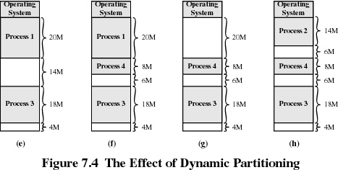

Slide 23
How to satisfy a request of size n from a list of free holes.
First-fit: Allocate the first hole that is big enough
Fastest
May have many process loaded in the front end of memory that must be searched over when trying to find a free block

Slide 24
Next-fit
More often allocate a block of memory at the end of memory where the largest block is found
The largest block of memory is broken up into smaller blocks
Best-fit Allocate the smallest hole that is big enough; must search entire list, unless ordered by size. Produces the smallest leftover hole
Compaction is required to obtain a large block at the end of memory
Since smallest block is found for process, the smallest amount of fragmentation is left memory compaction must be done more often

Slide 25
Worst-fit: Allocate the largest hole; must also search entire list. Produces the largest leftover hole.
First-fit , next-fit and best-fit perform better than worst-fit in terms of speed and storage utilization.

Slide 26
Buddy System
In Buddy system memory blocks are available of size 2^{K} where L<= K<= U
Entire space available is treated as a single block of 2^{U}
If a request of size s such that 2^{U-1} < s <= 2^{U}, entire block is allocated
Otherwise block is split into two equal buddies
Process continues until smallest block greater than or equal to S is generated
Buddy system is compromise to overcome the shortcoming of fixed and variable partitioning scheme

Slide 27
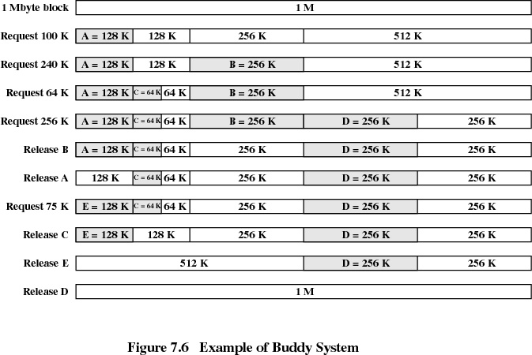

Slide 28
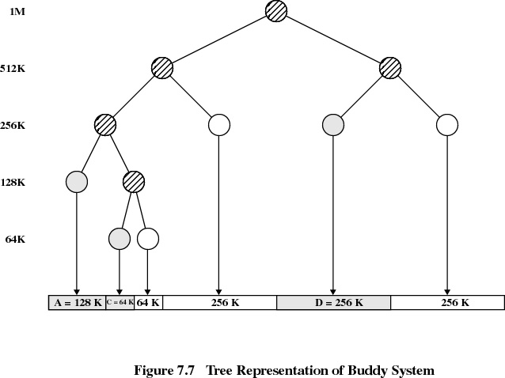

Slide 29
Fragmentation
External fragmentation –memory space exists to satisfy a request, but it is not contiguous.
Internal fragmentation – allocated memory may be slightly larger than requested memory; The additional space is unused
50 % rule. ( N allocated block & 0.5N waste)
Reduce external fragmentation by compaction
Compaction is possible only if relocation is dynamic, and is done at execution time.
I/O problem
Latch job in memory while it is involved in I/O.
Do I/O only into OS buffers

Slide 30
Assumptions
Allocate total required amount of memory
Allocate memory in contiguous manner

Slide 31
Observations
We realize that loading entire program in memory is wasteful as all the functionality of a program is not used simultaneously.
Can We load on Demand ?
In this case when the additional code is brought in memory the memory may not be available in contiguous manner
Relax the assumption of contiguous memory allocation

Slide 32
With Load on demand and Discontiguous allocation, we require
logical address to physical address mapping
Memory can be allocated in fixed size chunks
Or it can be allocated in variable size chunks

Slide 33
Memory Management
We have seen :
Static partition with equal & unequal partition
Internal fragmentation with fixed size partition
Dynamic Partition with variable size partition
External fragmentation
Compaction required to handle external fragmentation
Buddy systems

Slide 34
Memory allocation Problems
Internal fragmentation (fixed Partition)
External fragmentation (variable Partition)
Compaction
Contiguous allocation
The system may not have enough memory to hold complete program( Overlaying technique required)

Slide 35
Dynamic Partitioning (paging)
Memory is dynamically partitioned at run time and is allocated to processes
Logical address is generated by Instruction Pointer ( IP ) of the Processor . Instruction Pointer is also Known as Program Counter ( PC)
If the instruction pointer is 32 bit then the total logical address space would be 2³²
The logical address space is divided into fixed small size chunks (usually 4 KB to 4 MB ) known as page
If we use 4 KB page then the logical address space will have a total of (2 ³² ) / (2 ¹² ) = 2 ²⁰ pages

Slide 36
Dynamic Partitioning (paging)
The Physical memory is also divided into fixed size Block and are known as frames.
The size of frame and page is always equal for a given system
The frame and page size are always power of 2. Mainly for easy address computation

Slide 37
Paging
When process pages are required to be loaded into system , OS allocates required number of frames where process pages are loaded.
Frame need not be allocated in contiguous manner
If we have a process of size 13KB and page size is 4KB then process is allocated 4 frames .
Internal fragmentation occurs . Only last frame is partially filled .
It results into 18% unused space.
On an average internal fragmentation reduces

Slide 38
Logical to Physical Address Mapping
Page 0
Page 1
Page 2
Page 3
Page n
Frame 0
frame 1
Frame 2
Frame 3
Frame m
Physical Address
Logical Address

Slide 39
Address Translation Example
Consider 80X86 Processor based system which has
Byte organized Memory
32 Bit IP (logical address space 4GB)
Assume Address lines 32 (maximum Physical Memory 4 GB)
Page size 4KB

Slide 40
Logical Address
31
11
2
1
0
Page Number
offset
Logical address is divided into two parts , 12 bit offset within a page and 20 bit
page number
This logical address is translated to 32 Bit Physical address consisting of 12 bit
Offset and 20 bit frame number
The address translation is the job of Memory management unit (MMU) Hardware

Slide 41
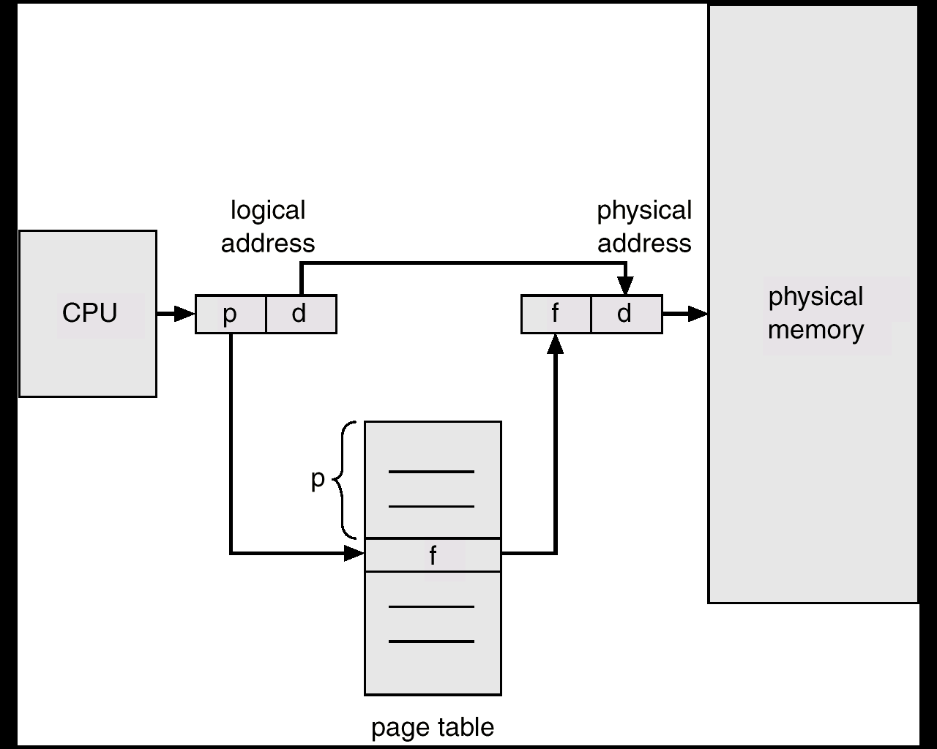
Address Translation Architecture

Slide 42
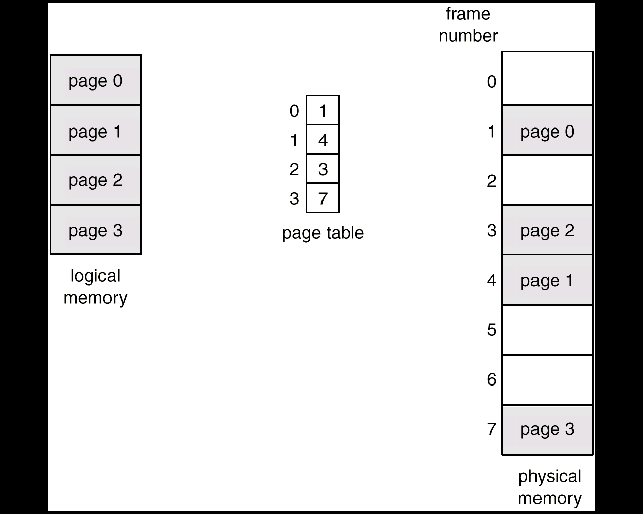
Paging Example

Slide 43
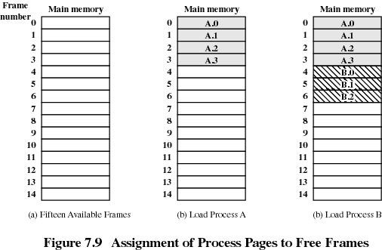

Slide 44
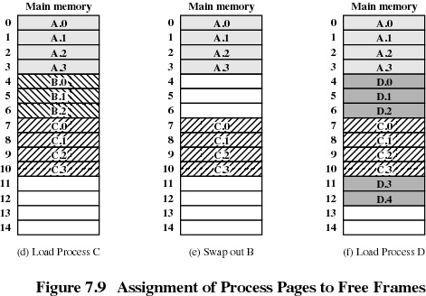

Slide 45
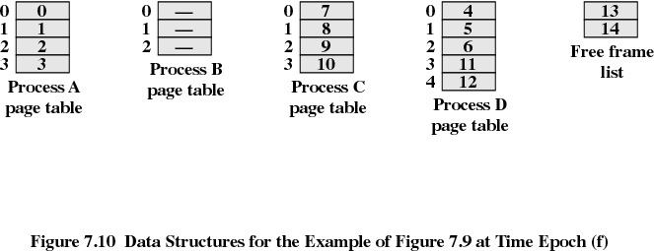

Slide 46
Paging : Issues
Internal fragmentation
To reduce internal fragmentation we need to reduce the page size.
If page size is small there will be an overhead of page table entry.
Page sizes now in use are typically between 4KB and 8KB.
Some CPU and kernel supports multiple page sizes. Example : Solaris 8KB and 4MB pages
Main advantage of paging is the separation of user view of memory & actual physical memory.
User process cannot access memory outside of its page table.

Slide 47
Implementation Issues
What is the minimum number of frame that can be allocated?
Where does page table resides in memory ?
How to reduce page table size?

Slide 48
Multilevel Page Directory

Slide 49
Minimum number of frame
Minimum number of frame to be allocated to a process is :
Dependent on Instruction Set Architecture ( ISA) . Eg.
ADD BX, LIST
If we assume that the opcode for above instruction is 3 byte then it s possible that first byte of Opcode is stored at last location of page and remaining bytes are stored in next page . Therefore we require two frame for code
In same manner we can argue for two byte data stored at location list. It is possible that first byte of data is stored at last location of page allocated for data and 2nd byte is stored in next page . This will mean we require 2 pages for storing operand
Therefore for above instruction we require minimum 4 frames . Two for data & two for code

Slide 50
Page table location
The base address of page table is specified using PDBR ( page directory base register )
In case if Intel processor CR3 Register acts as PDBR

Slide 51
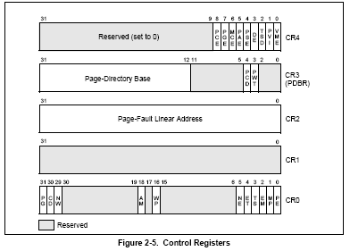

Slide 52
Multi level paging
The total number of pages can be grouped. So if we form a group of 1024 pages then we can have a total of 1024 such groups
We store the information about each group of pages in Page Directory and each group contains information regarding 1024 frames which is stored in page table
Each entry in page directory & page table is 4 byte

Slide 53
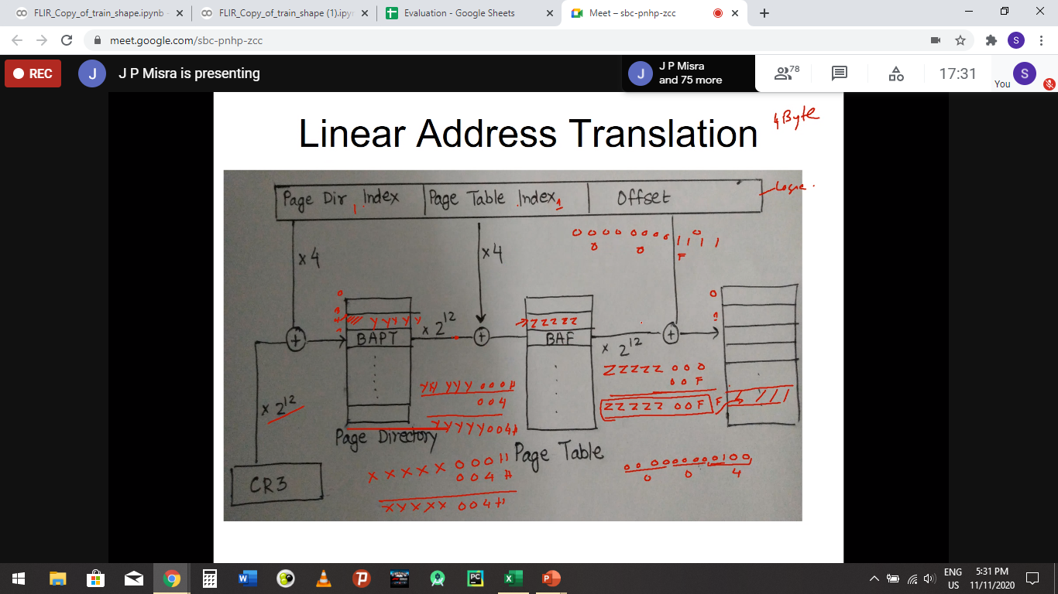
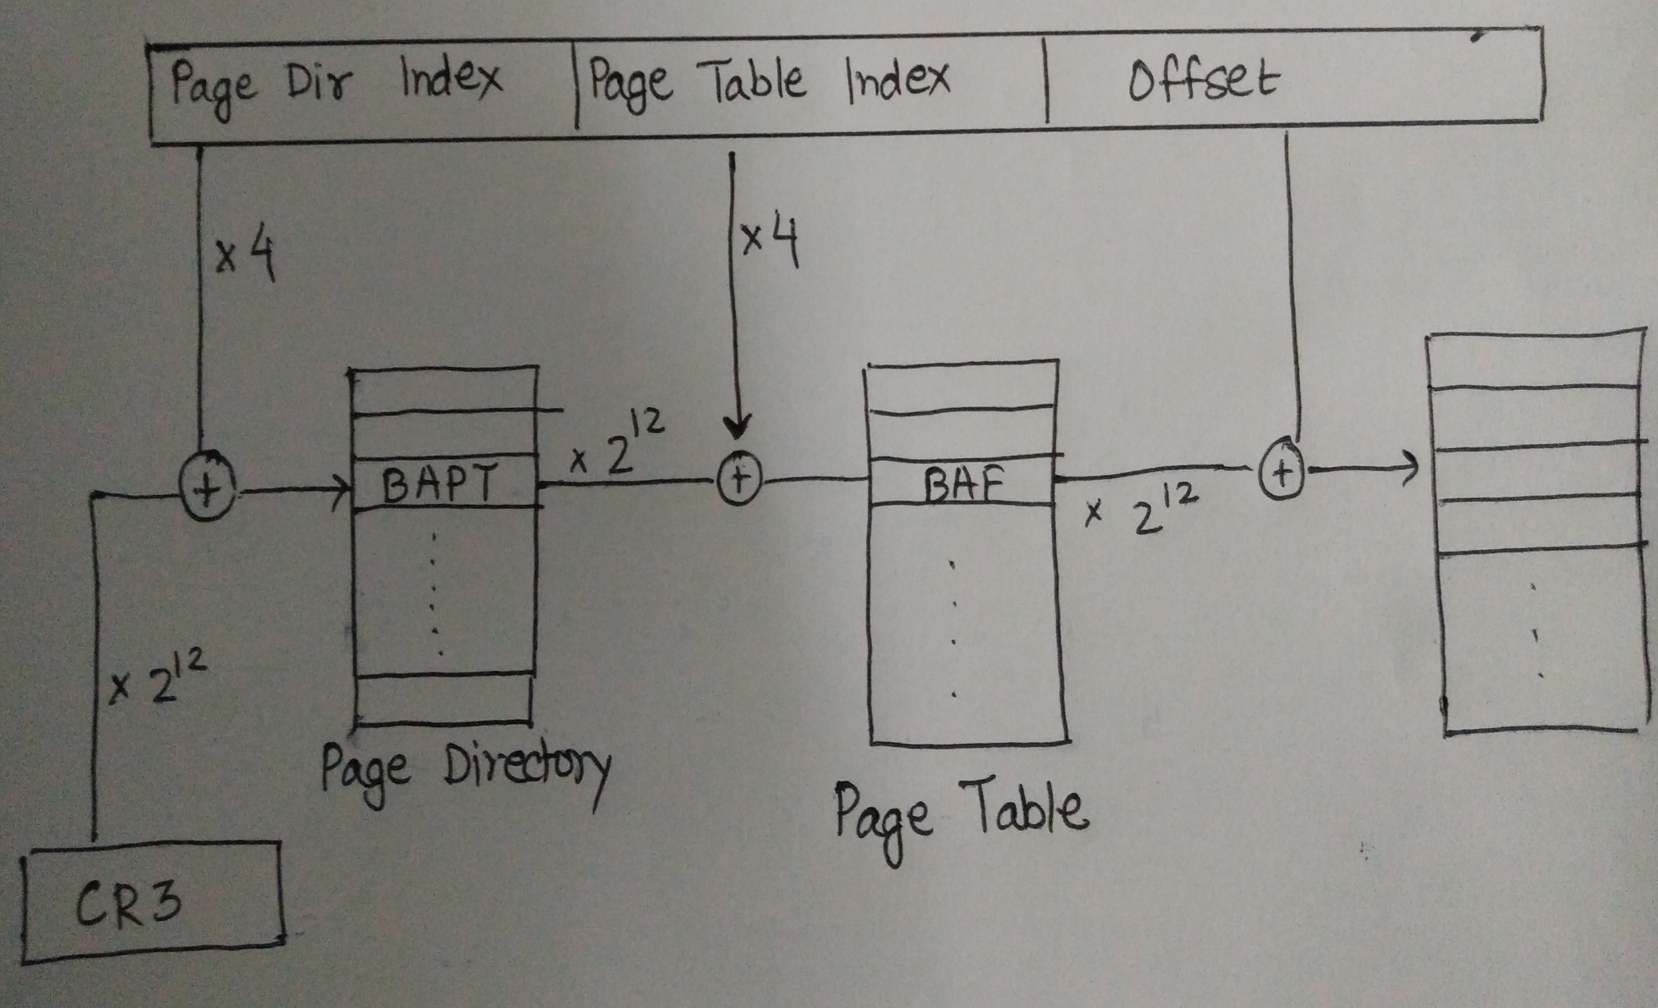
Linear Address Translation

Slide 54
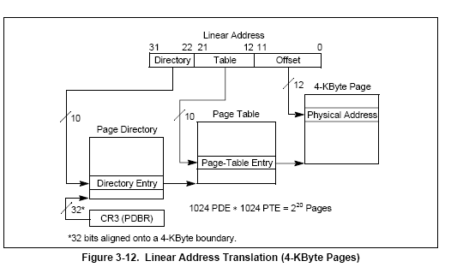

Slide 57
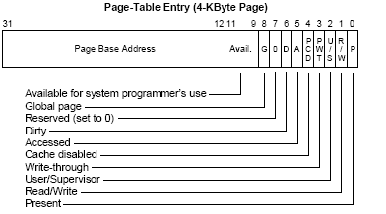

Slide 58
Paging summary
Multilevel paging helps in reducing the size of page table .
Paging suffers from internal fragmentation
Linear /logical to physical address translation is carried out by MMU ( memory management unit , implemented in hardware inside processor)

Slide 59
Paging : issues
If we need to access a byte from memory, it is required first we read 4 bytes from page directory , 4 bytes from frame and finally one byte of data.
We notice for reading 1 byte data , 8 bytes of additional information is required . This is huge overhead

Slide 60
Associative Register
The two memory access problem can be solved by the use of a special fast-lookup hardware cache called associative registers or translation look-aside buffers (TLBs)
Associative registers – parallel search
Address translation (A´, A´´)
If A´ is in associative register, get frame # out.
Otherwise get frame # from page table in memory
Page #
Frame #

Slide 61
Effective Access Time
Example
Hit ratio 80%
20 nsec to search in TLB
100 nsec to access Memory
Effective Memory Access Time
(E M A T) = (0.80 X 120) + (0.20 X 220) = 140 nsec
If hit ratio is 98% then
EAT = (0.98 X 120) + (0.02 X 220) = 122 nsec

Slide 62
Inverted Page Table
➔One entry for each real page of memory.
➔Entry consists of the virtual address of the page stored in that real memory location, with information about the process that owns that page.
➔Decreases memory needed to store each page table, but increases time needed to search the table when a page reference occurs.
➔Use hash table to limit the search to one or at most a few page-table entries.

Slide 63
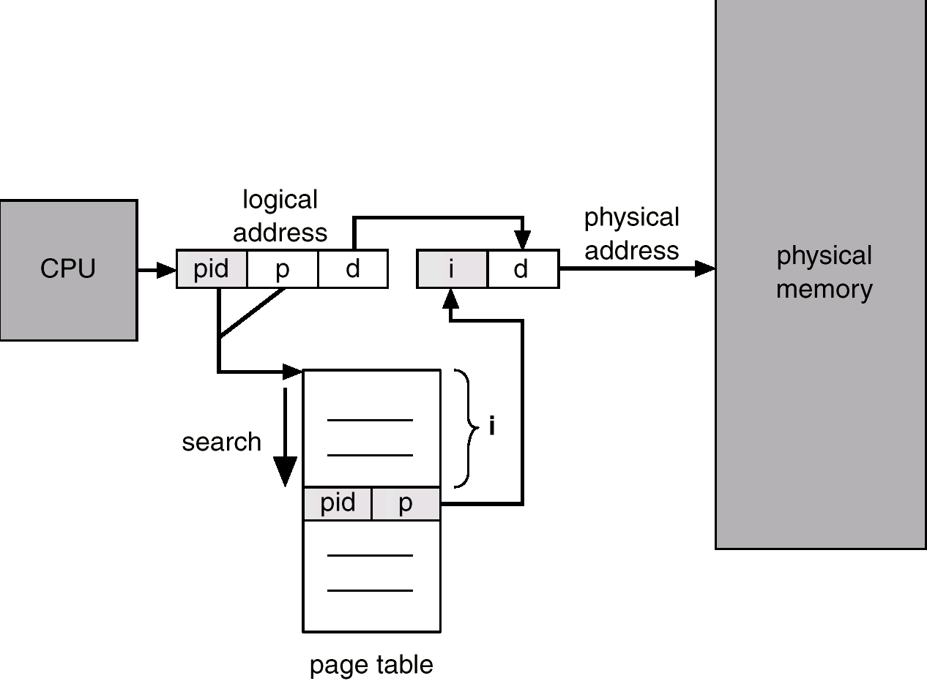
Inverted Page Table Architecture

Slide 64
Hashed Page Tables
Common in logical address spaces > 32 bits.
The virtual page number is hashed into a page table. This page table contains a chain of elements hashing to the same location.
Virtual page numbers are compared in this chain searching for a match. If a match is found, the corresponding physical frame is extracted.

Slide 65
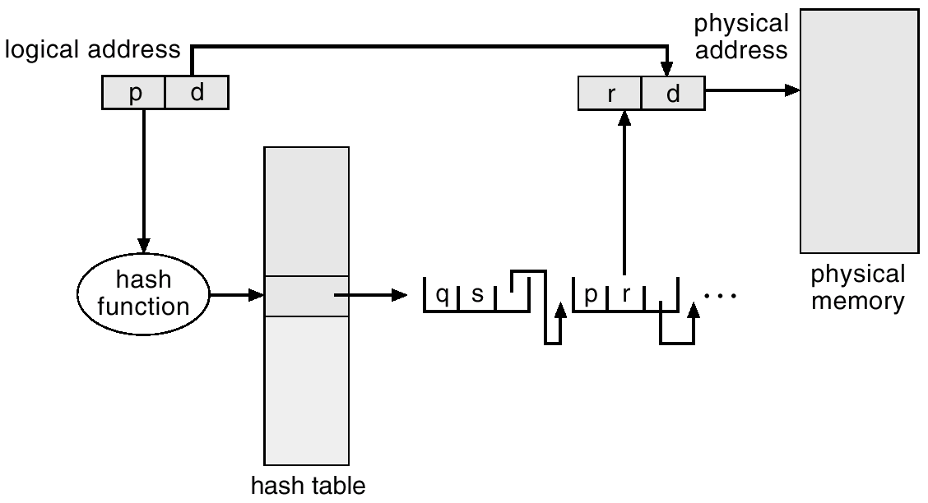
Hashed Page Table

Slide 66
Segmentation
Memory-management scheme that supports user view of memory.
A logical address space is a collection of segments.
A program is a collection of segments. A segment is a logical unit such as:
main program,
procedure,
function,
local variables, global variables,
common block,
stack,
symbol table, arrays
Address → segment : offset ( segment no, offset)

Slide 67
Logical View of Segmentation
1
1
4
2
3
4
2
3
user space
physical memory space

Slide 68
s
Limit
Base
CPU
Physical
Memory
Segment table
S d
<
+
Trap; addressing error

Slide 69
Segmentation Architecture
Segment table – maps two-dimensional physical addresses; each table entry has:
base – contains the starting physical address where the segments reside in memory.
limit – specifies the length of the segment.
Segment-table base register (STBR) points to the segment table’s location in memory.
Segment-table length register (STLR) indicates number of segments used by a program;
segment number s is legal if s < STLR.

Slide 70
Seg 0
Seg 3
Seg 2
Seg 4
Seg 1
1400
2400
Seg 0
 | Limit | Base
0 | 1000 | 1400
1 | 400 | 6300
2 | 400 | 4300
3 | 1100 | 3200
4 | 1000 | 4700
3200
Seg 1
Seg 3
4300
Seg 4
4700
Seg 2
5700
6300
6700

Slide 71
Segmentation Architecture (Cont.)
Relocation.
dynamic
by segment table
Sharing.
shared segments
same segment number
Allocation.
first fit/best fit
external fragmentation

Slide 72
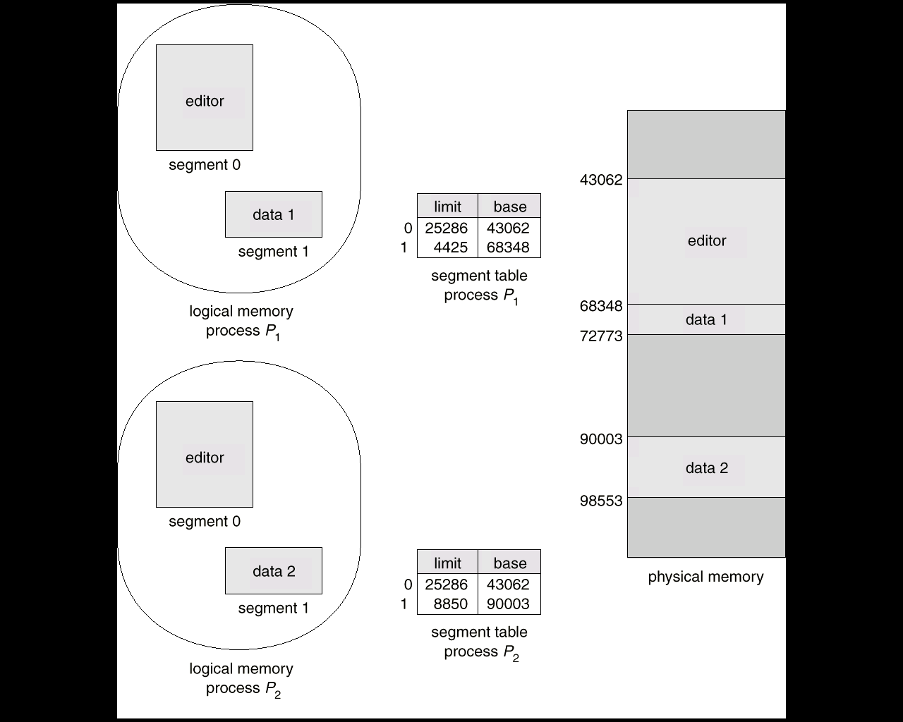
Sharing of segments

Slide 73
Segmentation In 80X86 Processor
Address is specified as Segment : Offset
X86 Processor has Several segment registers
CS (code segment)
DS (Data Segment)
SS (Stack segment )
ES (Extra segment)
GS & FS segment

Slide 75
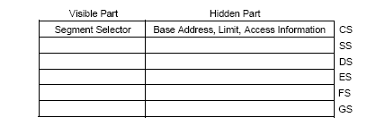

Slide 76
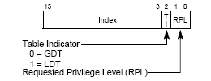

Slide 77
Memory Management Registers
Processor provides 4 memory management registers :
GDTR Global descriptor table register
LDTR Local Descriptor Table register
IDTR Interrupt descriptor Table register
TR Task register
These registers specify the location of data structure which control segmented memory management

Slide 79
GDTR Register
GDTR Holds
32 Bit Base address of GDT
16 bit limit value , defining size of GDT
On Power up/reset, Base part is set to 0 and limit is set to FFFFH
Each entry of GDT is of 8 bytes
LGDT, SGDT instruction can be used to load / store GDTR

Slide 80
IDTR Register
IDTR Holds
32 Bit Base address of IDT
16 bit limit value , defining size of IDT
On Power up/reset, Base part is set to 0 and limit is set to FFFFH
Each entry of IDT is of 8 bytes
LIDT, SIDT instruction can be used to load / store IDTR

Slide 81
LDTR Register
LDTR Holds
32 Bit Base address of LDT
16 bit limit value , defining size of LDT
Attribute for descriptor table
On Power up/reset, Base part is set to 0 and limit is set to FFFFH
Each entry of LDT is of 8 bytes
LIDT, SIDT instruction can be used to load / store IDTR

Slide 82
IDTR Register
IDTR Holds
32 Bit Base address of GDT
16 bit limit value , defining size of GDT
On Power up/reset, Base part is set to 0 and limit is set to FFFFH
Each entry of IDT is of 8 bytes
LIDT, SIDT instruction can be used to load / store IDTR

Slide 83
Logical Address to linear address Translation

Slide 84
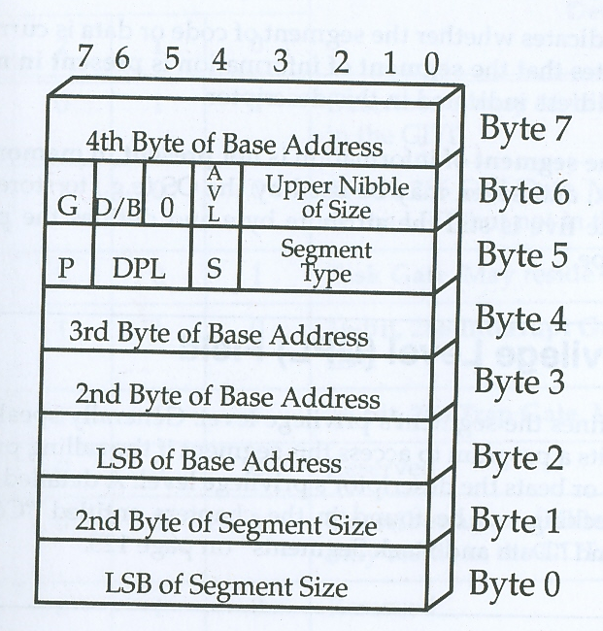
General Format for Descriptor table Entry

Slide 85
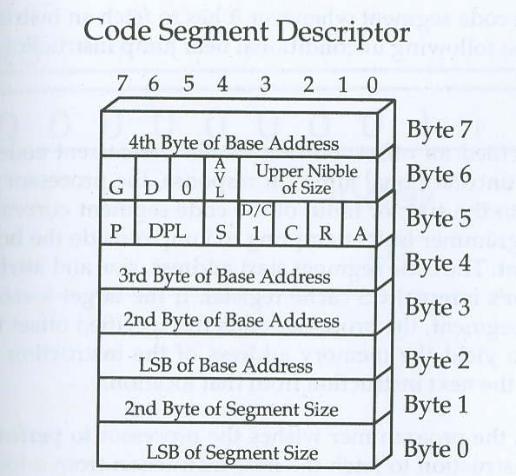

Slide 86
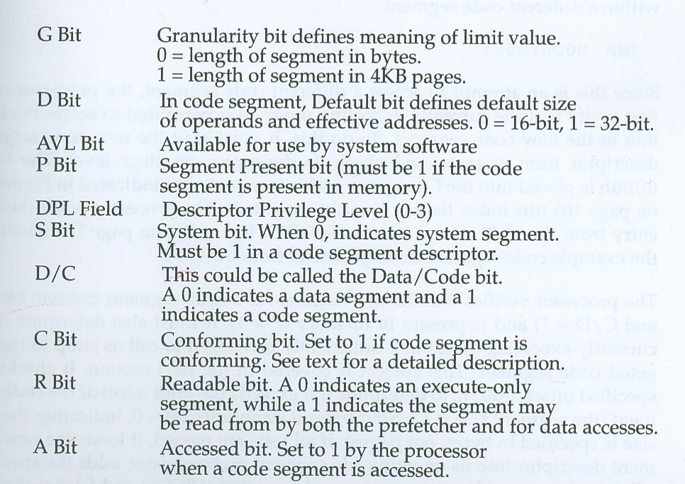

Slide 87
Conforming / non conforming code segment
C= 0 Non conforming
Non conforming code segment can only be accessed by programs whose CPL matches the target code DPL
C=1 Conforming code
Conforming code can be accessed by program whose CPL > Accessed code DPL
Accessed code runs at privilege of calling program

Slide 88
How a new code segment is accessed?
Execution of far jump
Execution of far call
Hardware interrupt or software exception
Initiation/resumption of new/ existing task
Execution of far Return
Execution of IRET

Slide 89
Context /task switch
On expiry of time slice, hardware interrupt is generated
On interrupt, control is returned to the OS
OS takes the snap shot of the executing process and save it in current task’s TSS
OS determines the next task to be executed, loads the context of new task from its TSS and starts execution

Slide 90
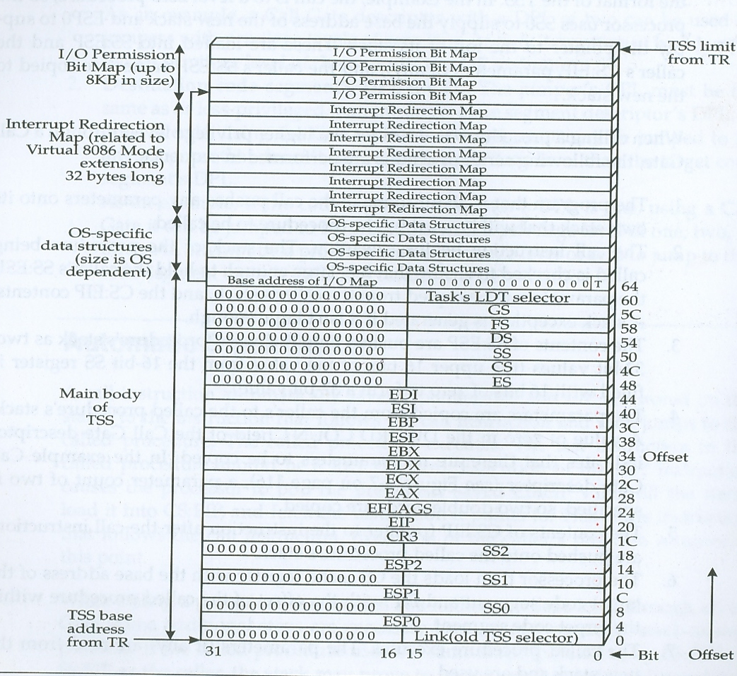

Slide 91
Role of RPL, CPL, DPL
When currently executing program executes a far jump
DPL is compared with max( CPL, RPL)

Slide 92
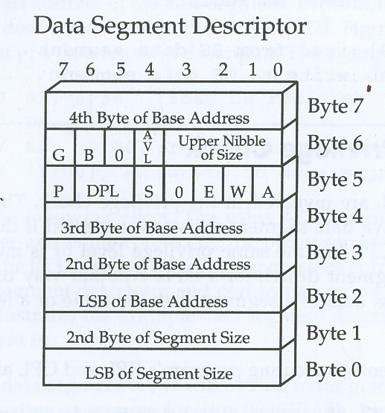

Slide 93
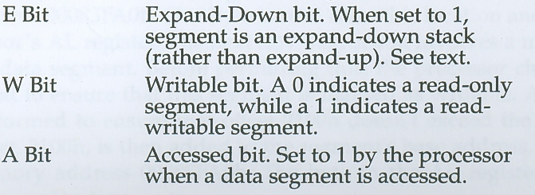

Slide 94
Expand UP/Down
Expand up
Lowest address ( BOS)= Base address
Highest Address (TOS)= Base +limit
Expand down
Lowest address ( BOS)= Base +limit-1
Highest Address (TOS)= Base + FFFFh or FFFF FFFFh

Slide 95
Privilege check in CS : Issues
Assume OS has a code segment with privilege level 0
It has number of procedures within this segments
Some of these procedures should only be accessed by OS code residing at privilege 1 or 2
Some of the procedures can be accessed by application at privilege 3

Slide 96
Call Gate
Call gate is special OS descriptor
May reside in GDT or LDT
It is used for transferring control to a procedure whose privilege level is equal or greater than calling program
Far call instruction can use call gate to transfer control to procedure with a higher privilege level
Far jump instruction can use call gate to transfer control to procedure with same privilege level or to a conforming code segment

Slide 97
Call gate
It contains indirect pointer to code segment and entry point
When Far call is executed
CS selector identifies the GDT/ LDT entry containing call gate
Offset of the far call is discarded . The actual offset is obtained from call gate

Slide 98
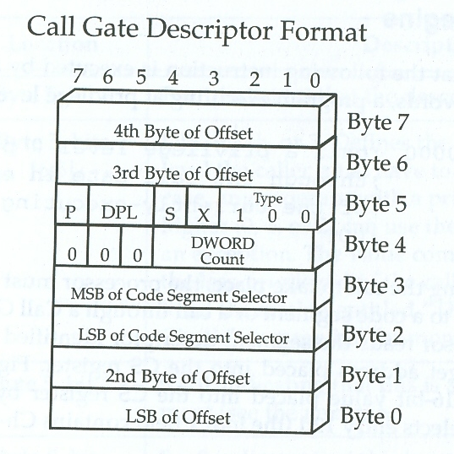

Slide 99
X =0 16 bit call gate
X=1 32 bit call gate
Dword count : number of dwords to be copied from caller stack to called stack
DPL defines minimum privilege level caller must have to use the gate
If DPL is 3 then any program with privilage level 3 or higher ( 0,1,2) can use gate

Slide 100
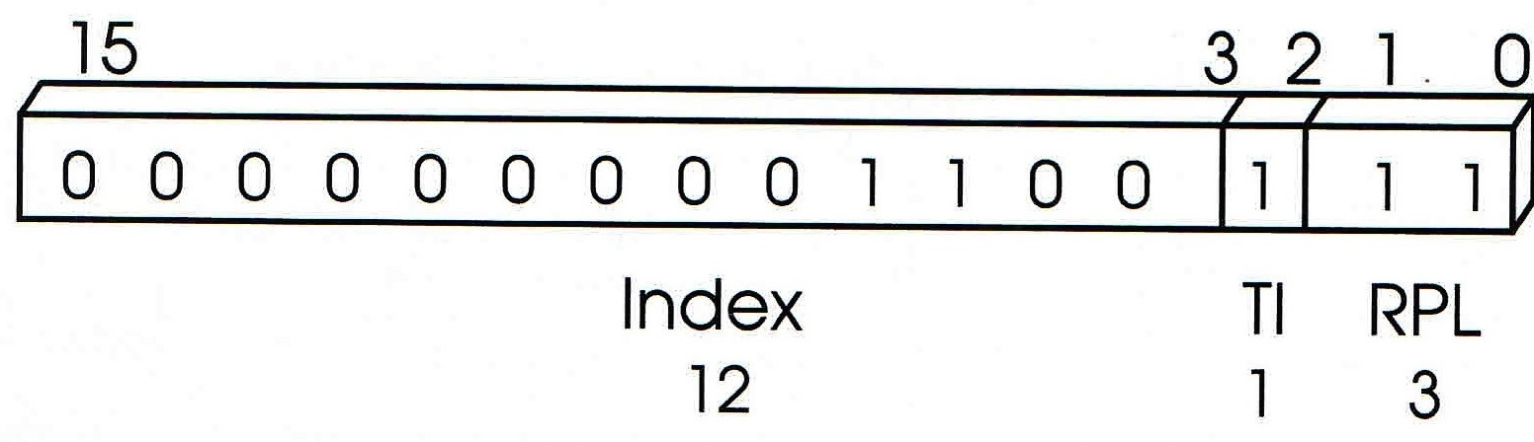
Call gate example
Call 0067h:0000h

Slide 101
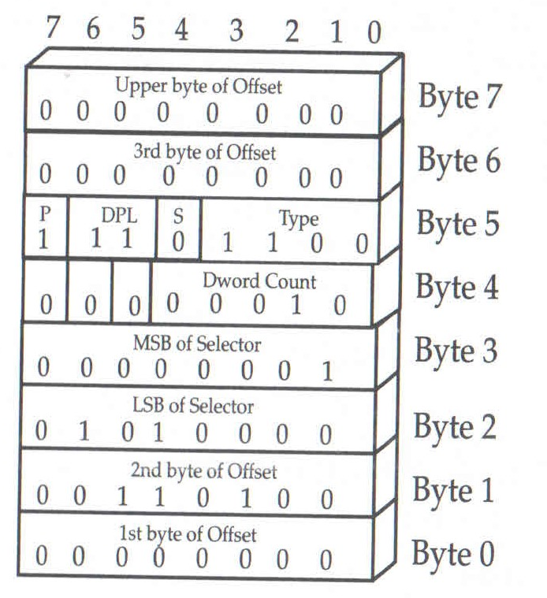
Call gate descriptor
Offset 3400h
Selector 0150h
D word count 2

Slide 102
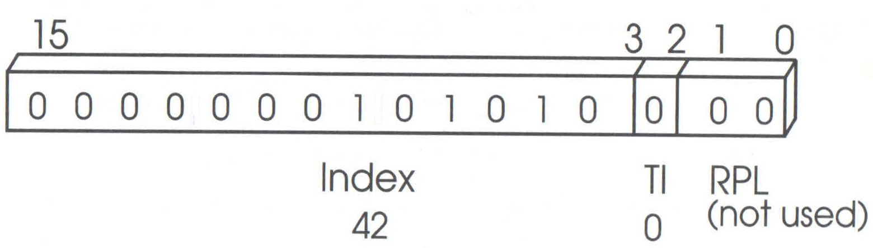
Call gate selector

Slide 103
Non conforming code
Base address :00131bcch
Size 1ee3dh
R=0 execute only
DPL 3

Slide 104
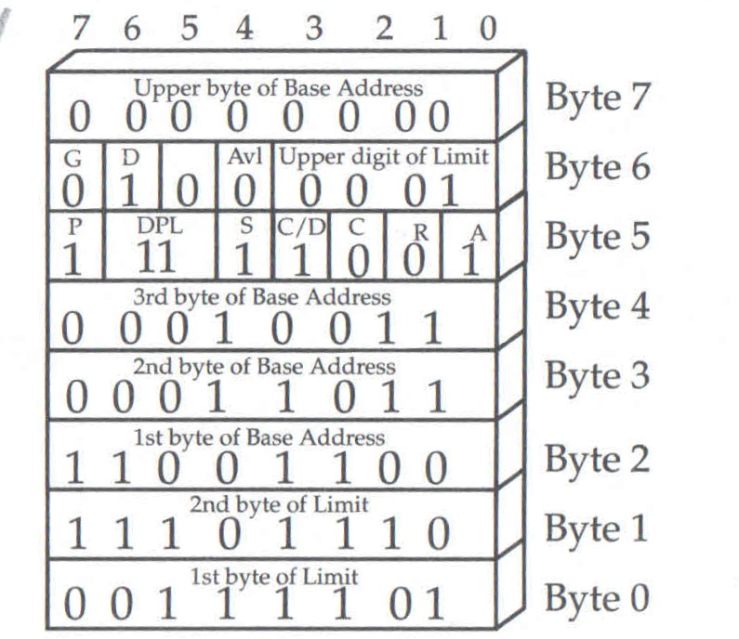
Code segment descriptor

Slide 105
Call gate privilege check using Far call
Call gate privilege check using Far call
Numerically greater of CPL and RPL <= call gate DPL
DPL of destination code segment <= CPL
Call gate privilege check using Far jump
Numerically greater of CPL and RPL <= call gate DPL
DPL of destination code segment = CPL

Slide 106
Protection Ring

